Slide 1
AI in Research Series
Workshop starts at 09:33

Slide 2
Retrieval Augmented Generation (RAG)
efrén cruz cortés

Slide 3
This workshop is brought to you by:
Northwestern IT Research Computing and Data Services
Need help?
AI, Machine Learning, Data Science
Statistics
Visualization
Data Collection, Cleaning​, Analysis, Management ...
Scraping, Text Analysis, Computing, Reproducibility ...
R, Python, SQL, MATLAB, Stata, SPSS, SAS, etc.
Request a FREE consultation at bit.ly/rcdsconsult.

Slide 4
Collaborative project support
We also provide longer-term support in your project!
Exploration
Modeling
Data collection, analysis, visualization, etc.
(Available for faculty or researchers with strong faculty support/involvement)
Find more information at bit.ly/collaborative_project_support

Slide 5
Bring Your Own Data (BYOD)
Weekly working group for mutual accountability and advice from our staff and other BYOD participants.
Great stress-free environment to progress on your research project!
Find more information at bit.ly/byod_groups

Slide 6
Logistics
Post-it notes 🟥 🟦
Questions or need help? → 🟥
Completed an exercise? → 🟦
Don’t be afraid to ask questions!

Slide 7
AI’s Impact
AI relies on extensive human labor, sometimes under exploitative conditions
Mining for minerals
Training, content moderation, etc.
AI relies on environmental resources
AI may impact people disproportionally and in undesirable ways

Slide 8
Warning!
Google Colab sends your data to Google’s servers.
Don’t upload any information you wouldn’t publicly share!
This includes data, code, API keys, people’s names, etc.
It is OK to use Google Colab for today’s workshop.

Slide 9
Teams and ice-breaking activity
Your table is your team. For exercises. I’ll pick a table and a volunteer can provide us with the answers.
2. If you are comfortable with it, take two minutes to introduce yourself to your team (and others if you have time).
(If you don't feel comfortable talking today, you can tell them "today I prefer not to talk" or provide a similar indication. It's fine.).
3. Pick a name for your team!
4. Now let's do a round of names and get used to asking questions!

Slide 10
What is RAG?

Slide 11
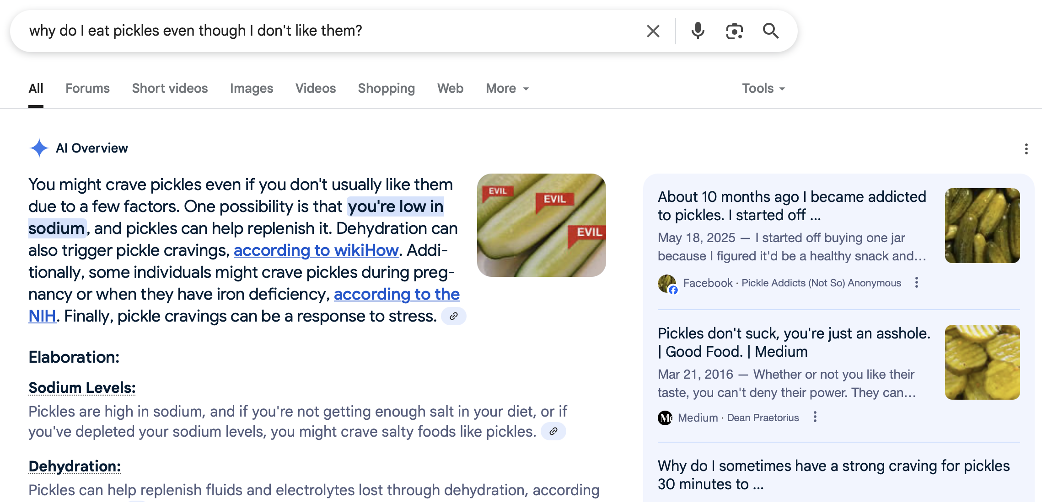
The new google
1
3
2
Query
“Ground truth” – source of data to be ingested by LLM
LLM’s summary of data relevant to the query.

Slide 12
Google’s RAG
Retrieval – Articles relevant to your query are found and retrieved from The Internetz
Augmented - The LLM’s general ‘knowledge’ is augmented with specific information from retrieved articles
Generation - The LLM generates a response based on the augmented information

Slide 13
Why do we need RAG?
LLMs foundation knowledge is insufficient
The data you’re looking at may not be in the original training data
The data sources may not be salient enough to be encoded in the model
The LLM’s context window is limited
In theory, you could provide all your data to the model
But it doesn’t have the capacity to process it
So we need to be more selective

Slide 14
RAG Examples
Google’s new results
You have a large dataset of academic papers from one discipline, and want to do a literature review or a metareview, or find if someone has published something similar to you, or just build knowledge based on unknown ideas
You have a collection of medical images, and want to find the ones that better match a patient’s textual description
You have a collection of movie scripts, and want to summarize dialogue on climate change in postapocalyptic film
etc...

Slide 15
How does RAG work?
Create a database to take data from
This is like a library, the ultimate source of information
For a given query, find the relevant elements from the database above
This is like finding specific books or papers in the library
Provide to the LLM only the relevant data, and let it work
This is like a graduate student of your own doing literature review for you 🫠

Slide 16



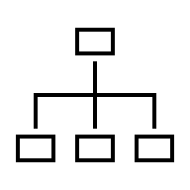
RAG Flow Diagram
Original Data
Query
Generation
Vector Database
Index

Slide 17
The Library of Babel
How do we know which parts of the data are more relevant to the query?
→ Not a trivial task!
But efrén, I read Borges’ “The Library of Babel”...
Is there an efficient way of finding the data we’re looking for?
The ultimate cypher, the index of all books?

Slide 18
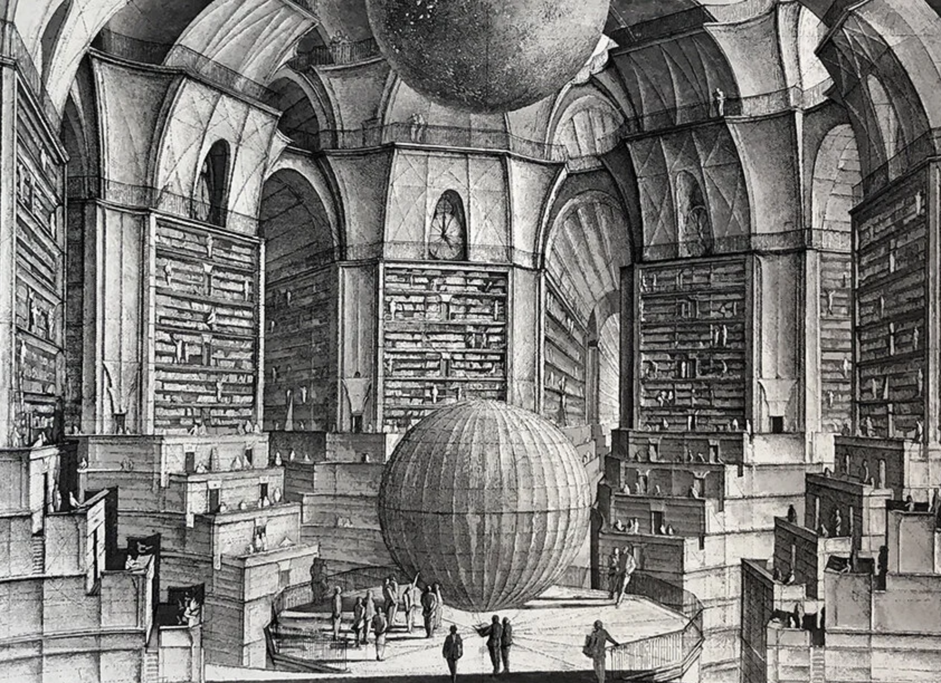
The Library of Babel
“The universe (which others call the Library) is composed of [a] .. perhaps infinite number of hexagonal galleries ...
When it was announced ... the Library contained all books, the first reaction was unbounded joy. All men (sic) felt themselves the possessors of an intact and secret treasure ...
That unbridled hopefulness was succeeded ... by a similarly disproportionate depression. The certainty that some bookshelf in some hexagon contained precious books ... forever out of reach, was almost unbearable ...
On some shelf in some hexagon, it was argued, there must exist a book that is the cipher and perfect compendium of all other books ... ”
Jorge Luis Borges, The Library of Babel
Illustration by Érik Desmazières

Slide 19
Understanding RAG

Slide 20
Concept 1 - Embeddings
Embedding refers to the process of representing a word, text or full document as a mathematical vector
By doing so we can manipulate unstructured objects (text) as if they had mathematical structure
Importantly, we get a sense of which words, sentences, or documents are close to each other!! (see next concept)

Slide 21
Embeddings example – words
Chimpanzees, gorillas, and orangutans have been living for hundreds of thousands of years in the forest, living fantastic lives.
(Jane Goodall)
Gorillas
Chimpanzees
Orangutans
Forest

Slide 22


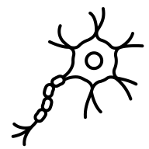









Embeddings example – Documents

Slide 23
Embeddings example – Documents

Slide 24
Embeddings example – Documents

Slide 25
Embeddings example – Documents

Slide 26



Embeddings example – Documents
Notes:
Does this look familiar to those who came to topic modeling??

Slide 27
Not only text!
You can have embedding models for:
Text
Images
Video
Audio
Other, more exotic data types
Multimodal (combinations of the above)

Slide 28
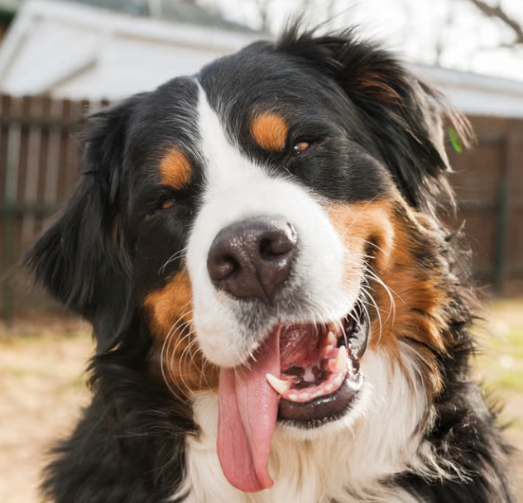

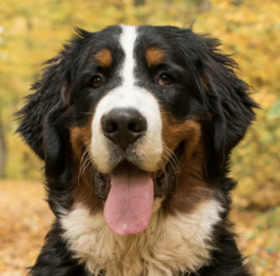
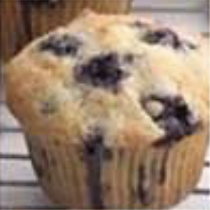

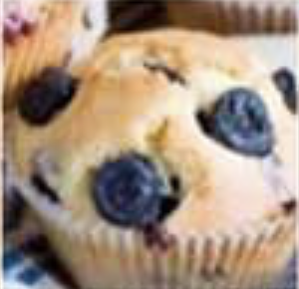
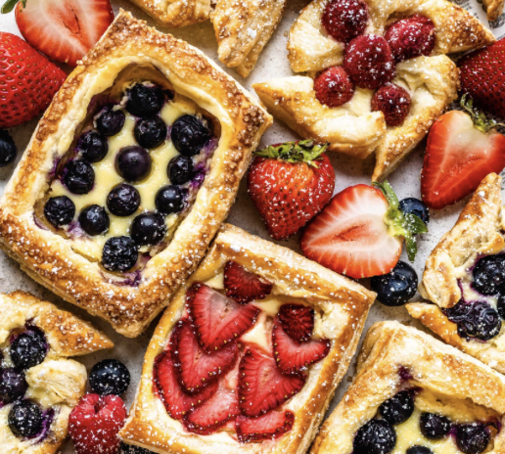

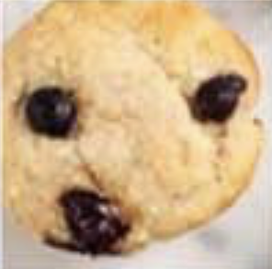

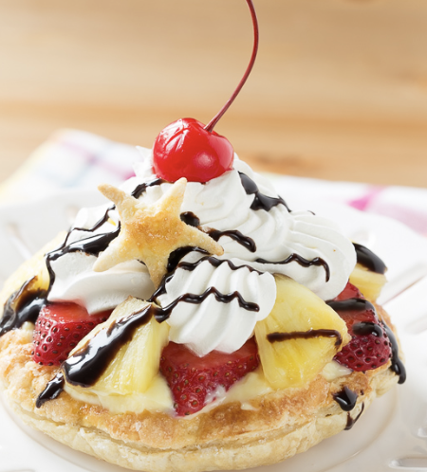
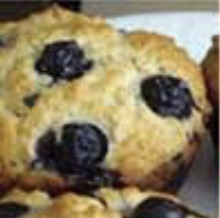
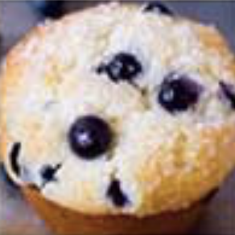
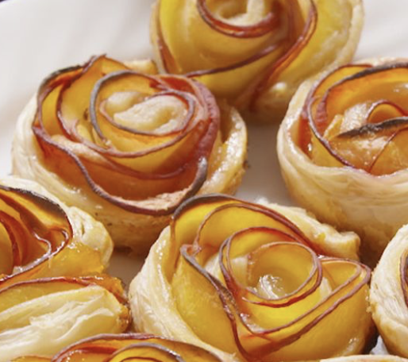
Images

Slide 29
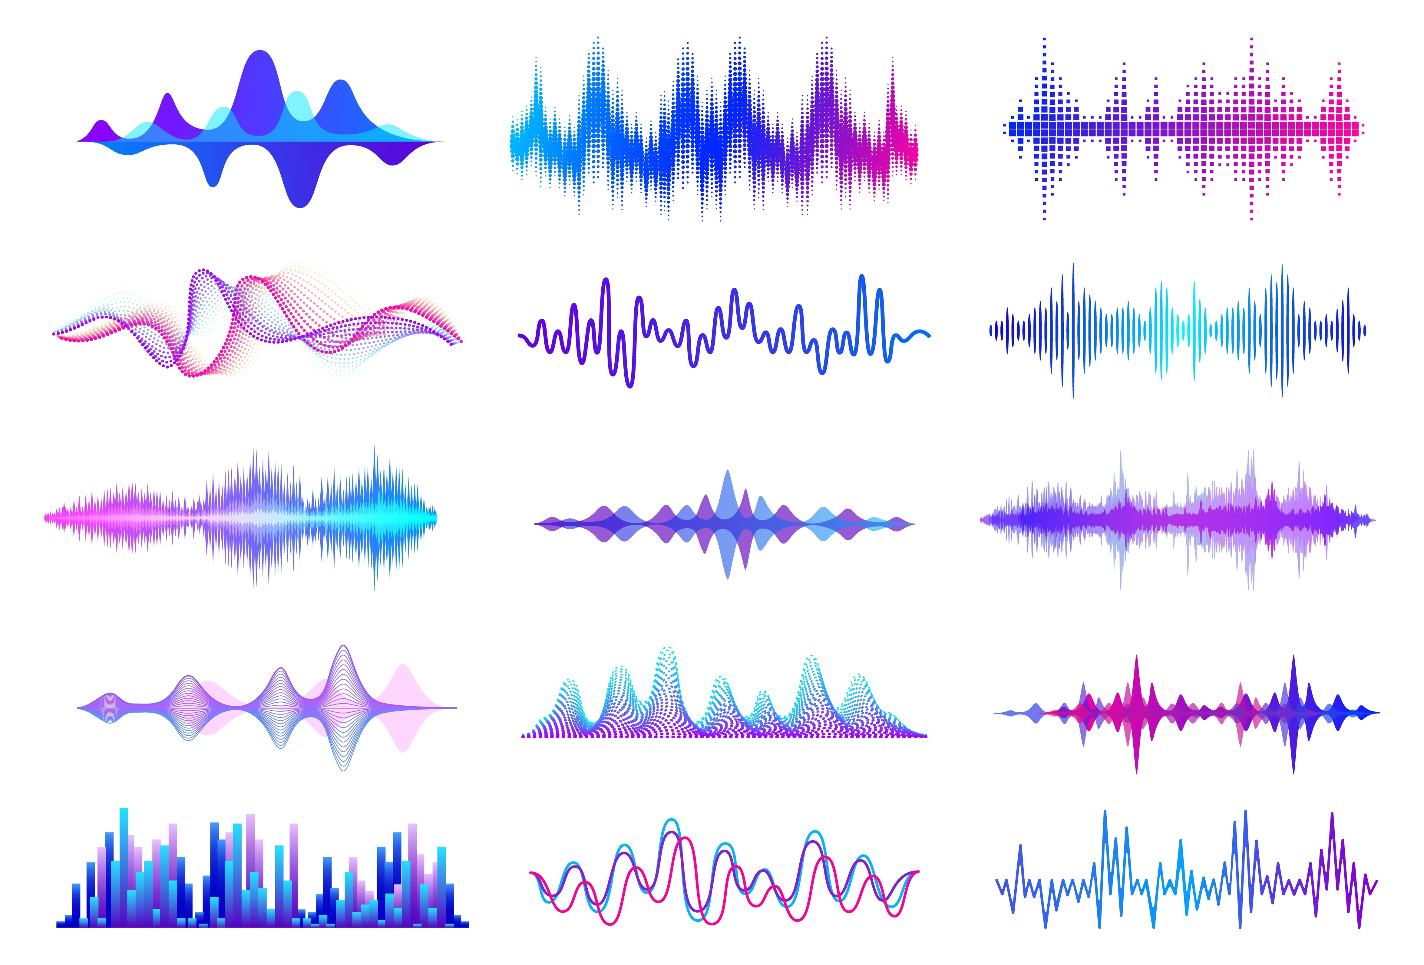

Audio
Spongebob
Scooby Doo
Morgan Freeman
Adele
efrén

Slide 30
Audio
Spongebob
Scooby Doo
Morgan Freeman
Adele
efrén

Slide 31
Audio
Spongebob
Scooby Doo
Morgan Freeman
Adele
efrén

Slide 32
Audio
Spongebob
Scooby Doo
Morgan Freeman
Adele
🤔
sus ...
efrén

Slide 33
Concept 2 – Distance and Similarity
Once data is represented as vectors we can measure how close one point is from another
→ Through a distance or a similarity
The most common approaches are:
Euclidean distance
Cosine similarity

Slide 34
Euclidean distance
Good ‘ol distance we all know and love
Which points are close to each other, and which are far?

Slide 35
Euclidean distance
Far
Close

Slide 36
Cosine similarity
Measures angle between vectors
Which points are more angle-similar to each other?

Slide 37
Cosine similarity
Measures angle between vectors
Close
Far

Slide 38
Note!
For “similarities”, higher similarity means closer (opposite of distances)
The highest cosine similarity (two vectors align perfectly) is 1
Close (high similarity)
Far (low similarity)

Slide 39
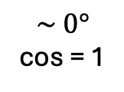
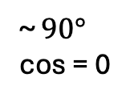
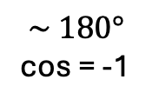
Cosine Similarity
~ $90°$
cos = 0
$$\sim 0°$$
cos = 1
$$\sim 180°$$
cos = -1

Slide 40
Why cosine in text?
Here, angle matters more than magnitude!
ESPN episode
ESPN Italy?
Mentions of balls
ESPN football article
Meatball recipe
IKEA’s cooking book
Mentions of tomato sauce

Slide 41
Why cosine in text?
Here, angle matters more than magnitude!
ESPN episode
ESPN Italy?
Mentions of balls
ESPN football article
Meatball recipe
IKEA’s cooking book
Mentions of tomato sauce

Slide 42
Concept 3 – Search
To find the most relevant points to my query, I could...

Slide 43
Concept 3 – Search
1. Compute the distance to all points

Slide 44
Concept 3 – Search
1. Compute the distance to all points
Euclidean distance

Slide 45
Concept 3 – Search
2. Determine which are closest.
Euclidean distance

Slide 46
Concept 4 – Search
3. And retrieve only the chosen ones.
Query
Relevant Information

Slide 47
Search
But this is not very efficient, and becomes prohibitive with large datasets and a large number of queries. So we need to organize information to find things faster.
This is akin to your searching for a book at a library, you don’t go book by book until you find the one. You use the library indexing system to go to the correct floor, then the correct section, then the stand, etc...

Slide 48
Concept 4 - Indexing
Indexes are structures that help you search more effectively.
There are different types of indices, and we won’t go over their specifics, but we can develop intuition with a simple example.

Slide 49
Indexing
Query
Data Point

Slide 50
Indexing
Query
Data Point
Cluster (Euclidean)

Slide 51
Indexing
Query
Data Point
Cluster (Euclidean)
Cluster representative

Slide 52
Indexing
Query
Data Point
Cluster (Euclidean)
Cluster representative

Slide 53
Indexing
Much faster to only compute distances to stars first.
And skip completely the clusters that are too far away.

Slide 54
Indexing
The cosine case is conceptually the same, but in terms of cosine similarity
Query
Data Point
Cluster(Cosine)
Cluster representative

Slide 55
Models and tools

Slide 56
The transformer
Encoder
Encoder Only
Decoder
Decoder Only

Slide 57
The transformer
Encoders
These models allow us to perform embeddings!
mpnet, miniLM, nomic, etc.
Decoders
These models allow us to generate new text
llama, olmo, gemma, gpt, etc.

Slide 58
Indexing tools
We will be using:
faiss (facebook ai similarity search)
But there are others:
mongodb, chroma, etc.

Slide 59
Summary

Slide 60
RAG Flow Diagram
Original Data
Query
Generation
🗣️
Embedding
Embedding
- Indexing
- Search
Relevant Results
Vector Database
Index

Slide 61
Querying Strategies

Slide 62
Creating a concept vector
You can combine vectors to create a new sort of thematic or conceptual vector!

Slide 63
Semantic walk (interpolation)
You can create a path between two vectors, and find embeddings along the path!

Slide 64
Extra Material

Slide 65
Concept 4 – Normalization
Scaling vectors so they have length 1
1
1

Slide 66
Concept 4 – Normalization
Scaling vectors so they have length 1
1
1

Slide 67
Concept 4 – Normalization
They now live in the unit circle!!
1
1

Slide 68
Concept 4 – Normalization
IF vectors are normalized:
“Closest” Euclidean-wise is the same as “Most similar” cosine-wise
1
1

Slide 69
Index Search
Query
🗣️

Slide 70
Original Data
Vector Database
Embedding

